Slide 1
Dev Ops Approach Study
"Now, here, you see, it takes all the running you can do, to keep in the same place. If you want to get somewhere else, you must run at least twice as fast as that!”
- Lewis Carroll
January 19, 2015

Slide 2
Disclaimer and Disclosure of Information
DISCLAIMER
DISCLOSURE OF INFORMATION
The information contained within this Approach Paper is and shall remain the property of Capgemini Finland Oy. This is an approach paper only and supplied in strict confidence and must not be produced in whole or in part, used in tendering or for manufacturing purposes or given or communicated to any third party without the prior consent of Capgemini Finland Oy.
Any information in this Approach Paper is not, and shall not be construed as, a formal offer for acceptance.
Assumptions and the scope for the services will be jointly verified during the LOI and contract negotiation phase. Capgemini is happy to work with SOK to get to a final contract that replaces this Approach Paper.
This Approach Paper is supplied in strict confidence and the information contained in this Approach Paper includes information the disclosure of which would be likely to cause significant harm to Capgemini’s commercial interests. Therefore, information contained in this Approach Paper must not be disclosed (in whole or in part) in response to any request for information without Capgemini’s prior written consent.
© Capgemini 2015

Slide 3
Abstract
Today we have a very dynamic IT infrastructure setup, with seamless integration of public, private and hybrid cloud with traditional datacenters as well as virtualized datacenters with mixed environments running Linux, UNIX and Microsoft operating systems.
Rather than sacrificing quality or uptime because of avoidable human errors, DevOps methodology and practices of agility and automation aims to reduce human interaction with code and infrastructure, allowing development and other teams to focus on their primary objectives and business.
DevOps approach aims to achieve continuous integration and continuous delivery, earlier delivery of new functionality, enabling shorter feedback loops.

Slide 4

What are we Trying to Solve?
What are we Trying to Solve?
Large amount of time required to configure new environment.
Manual configuration changes are prone to errors.
Differences in configuration of each environment.
Lack of version control for configuration
Late delivery of new functionality, only three times a year
No feedback on released functionality
Number of incidents after a release
People not satisfied, leaving, not willing to improve
Handover instead of collaboration between IT operations and IT delivery
Misunderstanding of each others responsibilities
Different KPI’s
Many manual steps in the release management process
Achieve continuous integration and continuous delivery.
Maximizing predictability, visibility, and flexibility, while maintaining stability and integrity.
Transform transition, de-risk IT deployments, eliminate the excuse

Slide 5
How does your Business benefit?
Lower Cost
Reducing infrastructure provisioning and system integration cost.
Fewer employees working on developing and deployment
More Control
Gain visibility of IT spend, ensure governance on IT services and budget management, & reduce risk of overspend
More stable operating environments
New software/services that would otherwise not be possible
Software/services made available across more platform
Greater Speed
Faster order to market pathway
Speed to generate business revenue
Faster delivery of features
A reduction in spend on development and operations
Reduced time-to-market
Enterprise Security & Assurance
Maintaining enterprise level security, integrity and service levels
More time available to add value (rather than fix/maintain)
Increased collaboration between departments
Improved quality of our deployed applications
Quicker service restoration after a failed deployment

Slide 6
What is DevOps?
Wikipedia (http://en.wikipedia.org/wiki/DevOps):
a software development method that stresses communication, collaboration and integration between software developers and information technology professionals
Gartner (http://www.gartner.com/it-glossary/devops):
improve collaboration between operations and development teams; better utilize technology, especially automation tools
Why do we Need DevOps?
Achieve efficiency in terms of Use of Time
Stability, Predictability and Testability
Inventory of Code improves Efficiencies
Earlier delivery of new functionality, enabling shorter feedback loops
More functionality can be delivered
Higher quality of solutions amongst others by automating as much as possible

Slide 7
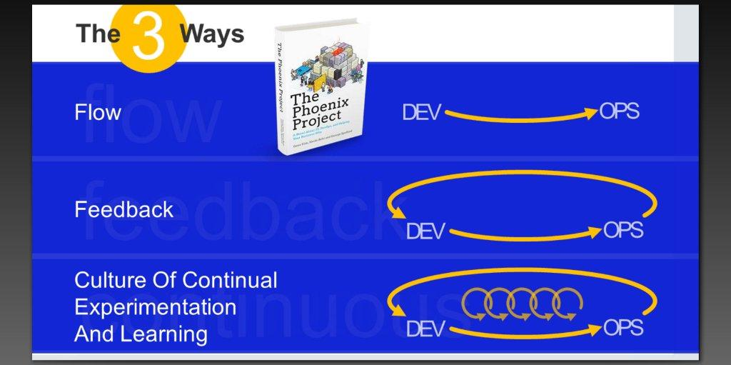

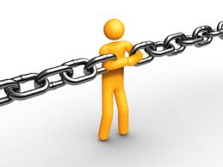
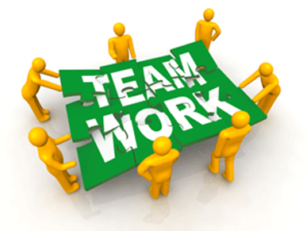
DevOps – in more Detail
New
Limit
Technical Debt
Get rid of
unplanned work
Remove
Bottlenecks
Burn down the silos (Bus/Dev/Ops), Create shared responsibilities
Types of work:
Business projects
Internal IT projects
Changes
Unplanned work

Slide 8
What is DevOps is not?
Change color scheme only: needs to match the slides
“DevOps is NoOps”
There is a misconception that with emergence of DevOps the traditional operations folks become irrelevant and the developers takes over operations. This is entirely incorrect, DevOps and its antecedents in agile operations, are mostly initiated by operations teams.
“DevOps is essentially Tools”
It’s also not “about the tools.” One reason why we want to have a more common definition or even manifesto of DevOps is that the risk of having various sub-definitions increases the risk that people will implement the processes or tools of DevOps without the principles in mind, which is definitely an anti-pattern.
DevOps “Myth-Busting”
“DevOps is everything”
There are times when people tend to overestimate the capabilities of DevOps making grandiose claims that it is “everything everywhere”, which is inaccurate. It is a part of overall collaborative approach and agility in corporate culture and DevOps is only how the operations plugs into that whole approach.
“DevOps is (Just) a Culture”
Many people insist DevOps “is just culture”, the culture of collaboration alone can help us achieve agility it needs to be supported by processes, practices and methodologies in line with the culture to achieve the end result.

Slide 9
Conceptual Approach to DevOps
Development
Unit Test
Functional Test
Non Functional Test
User Acceptance Test
Operational Acceptance Test
Live
Seamless Environment Build
Continuous Integration
On-Demand Scalability
Quality and Compliance
This diagram illustrates a pure waterfall approach – this is for illustration only. DevOps “works” with multiple approaches – i.e. parallel software development lifecycles (rapid, agile etc)
Development-to-Operations Challenges
DevOps “solutions”
Complex Pre-production / production build and run
Inefficient and complex error prevention and diagnosis
Siloed setup and narrow thinking – Wall of confusion
Increase in rate of change versus stability
Change culture
One Development-to-Operations Lifecycle
Common Tooling
Addressed by
Development-to-Operation Challenges and DevOps "solutions"

Slide 10
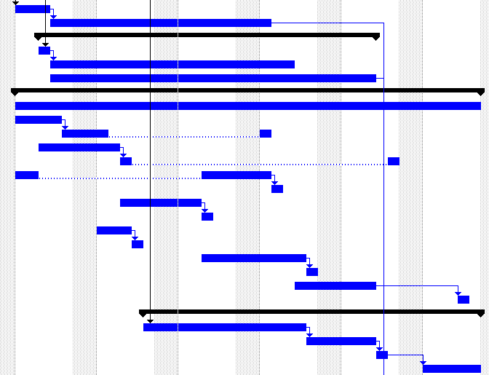

DevOps Implementation Framework (DIF)
The starting point
Overall Client’s Business Objectives, Sector wide drivers, External Drivers. IT Strategy
Tomorrow
A view on the target future State…
Today
Tomorrow
Target
Business, Developers, Testers, Operations.
…across all stakeholders…
Users
Users
Users
...covering end2end process and ...
... Using the process(es) to develop, test, train ...
Process
Process
Process
I (IS/TI)
I (IS/TI)
I (IS/TI)
... Technology landscape
... On application, middleware and infrastructure.
Issues, Risks, Challenges and constraints
The elements that constrains the As-Is to move to the interim and the To-Be
The Programmes of change that are needed to move the As-Is to the To-Be

Slide 11
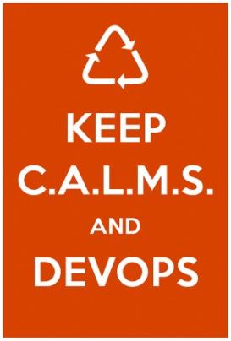
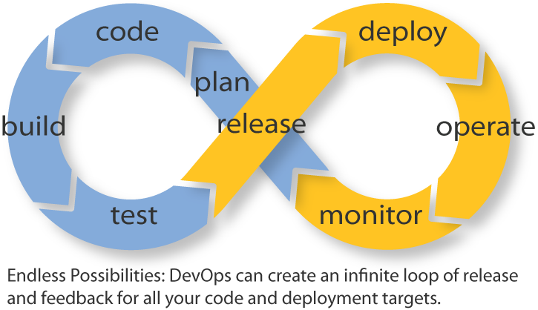
The DevOps Lifecycle
DevOps Lifecycle can be summed as:
The DevOps Lifecycle can be summarized as:
Check in code
Pull code changes for build
Run tests (continuous integration server to generate builds & arrange releases): Test individual models, run integration tests, and run user acceptance tests.
Store artifacts and build repository (repository for storing artifacts, results & releases)
Deploy and release (release automation product to deploy apps)
Configure environment
Update databases
Update apps
Push to users – who receive tested app updates frequently and without interruption
Application & Network Performance Monitoring (preventive safeguard)
Rinse and repeat
C – Culture
A – Automation
L – Lean
M – Measurement
S – Sharing

Slide 12
DevOps Advisory Services
STRAT
ARCHI &
INFRA
CASE
PLAN
CLOUD
New
APPS
Pre-sales and Start-up Activities
Phase 1 Mobilize
Phase 2
Prepare and Discover
Phase 3
Analyze &Recommend
Phase 4
Finalize & Present
Due Diligence
Workshops/ ASE
Storyboard and final presentation
Identify
Stakeholders
Select
Hypotheses
GRC and Operational
maturity
Business Drivers and Constraints
Gap Analysis
Risk Analysis and
Probability model
Transformation
Strategy
Next Steps
Identify Data Sources
Data Gathering
Target platform & Migration plan
Future Architecture Model
Install Data discovery tools
DevOps Transformation Roadmap
Benefits logic
Contracts and
License Costs
Target
Run Costs
Transformation
Costs
Business case
Select Business case Approach
TCO and As-Is costs baseline
Direct and Indirect
IT and Biz Benefits
Cloud Transformation
Cost structure
Identify and Plan SME interviews
Business Priority mapping
Transformation Planning
Transformation road map
Select Assessment
Approach
Data Gathering
DevOps Accelerator and DevOps Workbench
Data Sources
Identification
Inventory Data
Itrace Analyzer
Cloud Affinity
Report
DevOps Suitability Report
Identify App Owners
App Scan
App data collection,
catalogue population, and validation
App Disposition
App Rationalization Report
Automation Candidate
Identification
DevOps Release Cycle
DevOps Readiness Report
DevOps Analysis
ITRACE &
CG methodology
Common
New
Mandatory

Slide 13
DevOps Solution Approach
Initiation
Phase I
Phase II
1
2
3
Preparation workshops(Management awareness, sponsorship and active involvement is required)
Stakeholder huddle and DevOps Team identification
ITRACE DevOps analysis
Transformation approach and solution outline
Automation candidate identification.
Automation capability demonstration on existing AIX platform.
Automation of application Deployment and configuration on AIX
Re-platforming from AIX to x86 Architecture Solution (Application and platform)
DevOps Transformation Process(Repository Creation & Training)
Achieve Continuous integration and Continuous delivery
Automate and improve the process of software delivery, including integration and acceptance testing
Adoption of an approach in which teams ensure that every change to the system is releasable, and that we can release any version at the push of a button
Private Cloud migration on x86 Platform
Automated Provisioning, Deployment of Infrastructure (Infrastructure as code, Automated infrastructure, Release Management)
DevOps Release cycle adoption (extension of Continuous Integration and Continuous Delivery)
Automate the deployment of delivered software
Enable deployment after each sprint

Slide 14
Success Story (CMU Case Study)

Slide 15
Our Strategy Foundations
Continued Client Focus
Client Centricity drives our Service Value Chain
Services Evolution
‘End to end’ Services Catalogue based on a sound strategy and deep Sector expertise
Delivery Excellence
Sound foundations based on trust and keeping our promises
Embedded Innovation
Leveraging our passion for technology, our Partnerships and our People

Slide 16
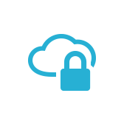
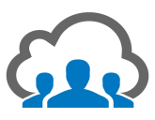
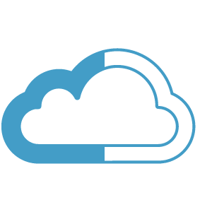
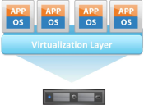
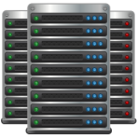
Conceptual Solution Architecture
Service Orchestration Engine
Orchestration
Dispatcher
Scheduler
Portal
Service Desk
Provisioning
SI Automation
Deployment
Puppet Master
Foreman
Configuration Management
Binary Repository
Code Repository
OS Boot/Install
Deployment Blueprints
Reporting
Integrate
APIs / Integrations
Public Cloud
Hybrid Cloud
Private Cloud
Virtualized Data-Centre
Traditional Data-Centre

Slide 17
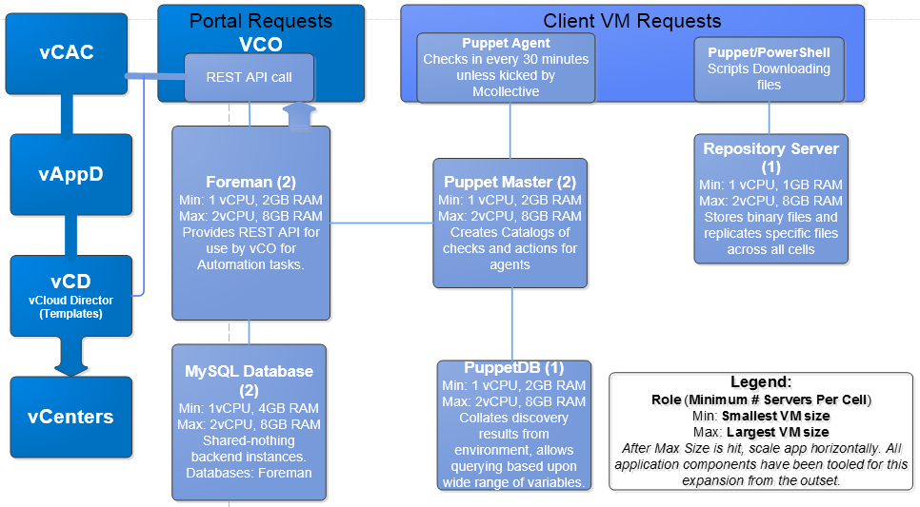
CMU Solution Overview
In Capgemini’s CMU (Cloud Management Unit), we have successfully implemented Infrastructure Automation and Infrastructure Orchestration for our tenant services. In order to meet CMU's strategic business needs, the automation team has explored open source tools that will complement our existing VMware products by enabling Lifecycle management, B2B InterOp, and virtual machine Configuration management. Puppet and Foreman are under a GPL Open Source License. They are complementary to the VMware Tools, and add further capability to the infra automation tool set. The following logical diagram illustrates the CMU platform components of vCO, vCAC, vAppD, and vCD that have been complemented by the additional infrastructure automation tools:

Slide 18
CMU Solution Components
Foreman is a life-cycle management tool that is used in conjunction with Puppet. Foreman acts as a centralized orchestration broker of workflow operations updates.
Foreman is also a STATEFUL repository of all work done by automations, and provides the capability of audit tracking of changes to virtual machines.
Foreman – Lifecycle Manager
Puppet DB - Local cached database of artifacts
Puppet Master - Policy and Configuration enforcement engine
Puppet agent - Embedded O/S that checks in with Puppet Master and applies pending updates
Puppet – Configuration Manager
VCloud Director (vCD)
VCloud Application Director (vAppD)
VCloud Automation Center (vCAC)
VCenter Orchestrator (vCO)
VMware Components

Slide 19

Anatomy of vCO to Foreman Workflow
Foreman will act as a RESTful “wrapper” around the Puppet provisioning tool, thereby enabling vCO workflows, real world life cycle management capabilities today. VCO work flows will coordinate activities (Puppet RESTful Functions lifecycle managed by Foreman Tools) which will completely document and validate all steps of a de-provision/provision for any requested workflow.
Infra Admin
Portal (Mendix)
F&S (Java)
Infra Orch(VCO)
Infra Auto (Foreman/Puppet)
Infra Cloud
Intiaize Organzaiton(e.g. create OrgVDC)
CreateVMs using VMware Tools
OrderCatalog (SI Small)
Provision
SharePoint- Small
Install WebProxy
Install CentralAdmin
Install Small DB
Handle Exception
PostInstall SharePoint-Small
CheckExecutionStatus
Returns Attributes / Error
Provision ITBM Small
Install Component1
Install Component2
Install Component3
PostInstall ITBM-Small
Handle Exception
CheckExecutionStatus
Returns Attributes / Error
Contine with Application 3
Contine with Application 4...

Slide 20
SOK EAI – X86 Transformation

Slide 21
x86 Transformation
1
Realize cloud benefits
License models with smart scaling support
Proven open-source technology available
2
EAI alternative implementation
Many efficient enterprise-level open source solutions exist
MuleESB: the most widely used open source ESB in the world, with over 3200 production deployments, including leading companies such as Walmart.com, Nestlé, Honeywell and DHL, as well as 85 in the Global 500 and 5 of the world’s top 10 banks.
Others:
JBoss Fuse ESB
WSO2
Talend
Apache Kafka and Zookeeper

Slide 22
x86 Transformation
3
What defines the future?
Adapters required for SAP integrations, XML/EDI traffic?
New service integrations?
4
EAI solutions have different strengths in different areas
Technology for purpose:
Files
Messaging and web service traffic

Slide 23
Next Steps?
Process Driven Technology
Right technology and solution to support the defined challenge scope
Prepare for the Change
Develops methodology for agile business
Value Chain Mapping
What drives your business now and in the future?
Which processes does the EAI support?

